Slide 1
BMEG3105-Model Evaluation in Python
Yixuan Wang(王艺璇)
Friday, October 7, 2022
yxwang@cse.cuhk.edu.hk
Department of Computer Science and Engineering (CSE)
The Chinese University of Hong Kong (CUHK)

Slide 2
Outline
From binary to multiclass and multilabel
Clustering performance evaluation
Rand index
Adjusted rand index
Cross-validation: evaluating estimator performance

Slide 3
From binary to multiclass and multilabel
Some metrics are essentially defined for binary classification tasks (e.g. f1_score, roc_auc_score). In extending a binary metric to multiclass or multilabel problems, the data is treated as a collection of binary problems, one for each class. There are then a number of ways to average binary metric calculations across the set of classes, each of which may be useful in some scenario.
“macro”: simply calculates the mean of the binary metrics, giving equal weight to each class
“micro”: gives each sample-class pair an equal contribution to the overall metric (except as a result of sample-weight)
“weighted”: accounts for class imbalance by computing the average of binary metrics in which each class’s score is weighted by its presence in the true data sample.
https://colab.research.google.com/drive/1cXnsuqGvmhsYB-Irl-tnsw1OEiqEpjom?usp=sharing
https://scikit-learn.org/stable/modules/generated/sklearn.metrics.classification_report.html

Slide 4
From binary to multiclass and multilabel
https://colab.research.google.com/drive/1cXnsuqGvmhsYB-Irl-tnsw1OEiqEpjom?usp=sharing
https://scikit-learn.org/stable/modules/generated/sklearn.metrics.classification_report.html

Slide 5


Clustering performance evaluation
Rand index:
a measure of the percentage of correct decisions made by the algorithm
Where:
TP is the number of true positives,
TN is the number of true negatives,
FP is the number of false positives,
FN is the number of false negatives.
$$RI∈[0,1]$$
https://scikit-learn.org/stable/modules/generated/sklearn.metrics.classification_report.html

Slide 6

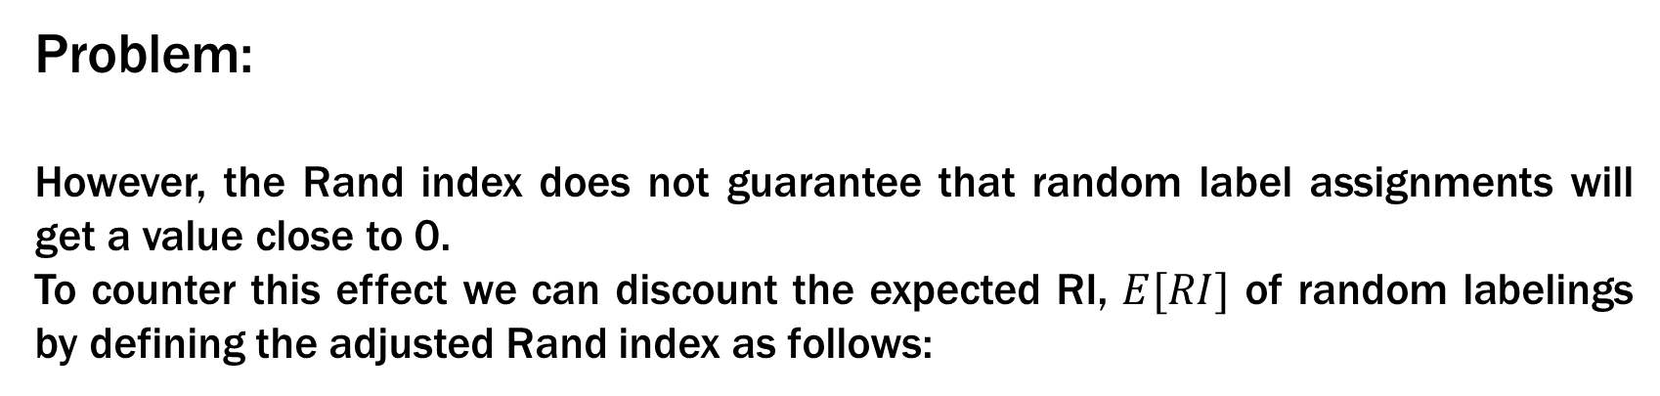
Clustering performance evaluation
Problem:
However, the Rand index does not guarantee that random label assignments will get a value close to 0.
To counter this effect we can discount the expected RI, $E[RI]$ of random labelings by defining the adjusted Rand index as follows:
https://scikit-learn.org/stable/modules/generated/sklearn.metrics.classification_report.html

Slide 7
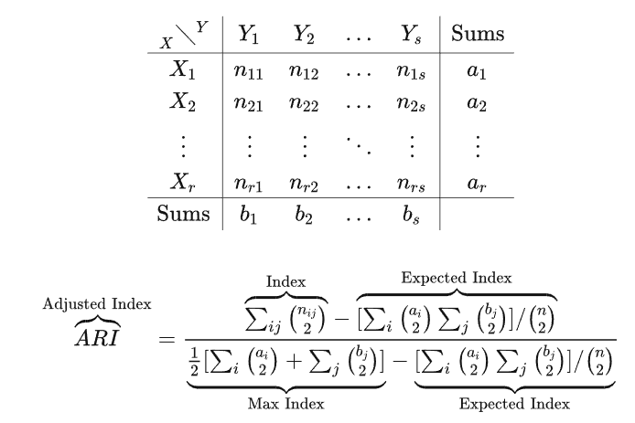

Clustering performance evaluation
Adjusted rand index:
Given a set S of n elements, and two groupings or partitions(e.g. clusterings)of these elements, namely class(X) and cluster(Y). The overlap between X and Y can be summarized in a contingency table, where each entry n_ij denotes the number of objects in common between X_i and Y_j
https://scikit-learn.org/stable/modules/generated/sklearn.metrics.classification_report.html

Slide 8
Clustering performance evaluation
https://colab.research.google.com/drive/1cXnsuqGvmhsYB-Irl-tnsw1OEiqEpjom?usp=sharing
https://scikit-learn.org/stable/modules/generated/sklearn.metrics.classification_report.html

Slide 9
Cross-validation:
evaluating estimator performance
https://colab.research.google.com/drive/1cXnsuqGvmhsYB-Irl-tnsw1OEiqEpjom?usp=sharing
https://scikit-learn.org/stable/modules/generated/sklearn.metrics.classification_report.html

